Slide 1

Report from the ASO AC
https://aso.icann.org/

Slide 2
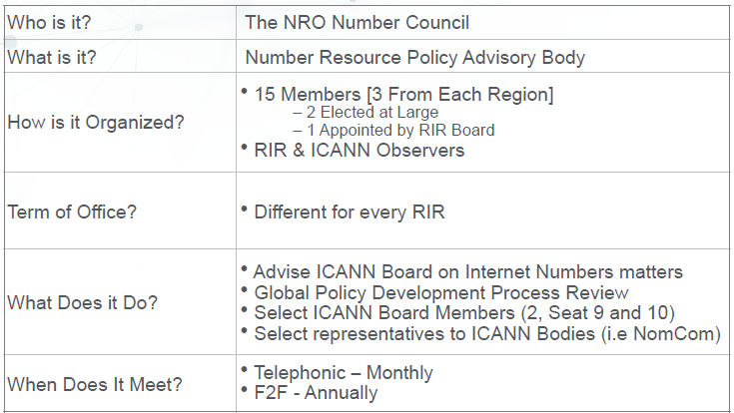
The ICANN ASO AC (Address Council)

Slide 3




2021 Address Council Members
REGION | Member | Term
 | TBC Mike Silber [Vice Chair] Saul Stein | Jan 2022 – Dec 2023 Jan 2020 – Dec 2022 Jan 2021 – Dec 2023
 | Shubam Saran Nicole Chan* Di Ma | Jan 2021 – Dec 2022 Jan 2022 – Dec 2022 Jan 2022 – Dec 2023
 | Kevin Blumberg* [Chair] Martin Hannigan Chris Quesada | Jan 2021 – Dec 2023 Jan 2020 – Dec 2022 Jan 2022 – Dec 2024
 | Esteban Lescano* Ricardo Patara Jorge Villa | Apr 2021 – Mar 2022 Jan 2021 – Dec 2023 Jan 2021 – Dec 2023
 | Hervé Clément* [Vice Chair] Sander Steffann James Kennedy | Jan 2021 – Dec 2023 Jan 2022 – Dec 2024 Jun 2021 – Dec 2022
Remark: The community appointed ASO AC members in the RIPE region also serve on the IANA RC (Sander Steffann and James Kennedy)

Slide 4
Global Policy Development
ASO AC members follow their respective RIR’s policy forum for any proposed global policy
There has been no global policy in the last years
A dedicated ASO AC meeting occurred last October
2022 Policy Proposal Facilitator Team (PPFT)
  Mike Silber (AfriNIC)
  Shubham Saran (APNIC)
  Martin Hannigan (ARIN)
  Ricardo Patara (LACNIC)
  James Kennedy (RIPE NCC)

Slide 5
ASO AC Transparency
Annual Face to Face meeting
  OPEN to observers (except for discussion related to ICANN Board Elections)
  Since 2020 the work has been taken place online – next 2022 ICANN meeting will be in June in The Hague
AC-DISCUSS mailing archive has OPEN public records
  https://aso.icann.org/pipermail/ac-discuss/
ASO AC Monthly Teleconference are OPEN to observers
  Normally first Wednesday of the month a 12:00 PM UTC
  2021 Meeting Calendar
  https://aso.icann.org/aso-ac/meetings/aso-ac-meeting-schedule/

Slide 6
ASO AC Appointments
ASO AC Current Appointments
Maemura Akinori
  Seat 10 ICANN Board, 2019 - 2022 (from APNIC Region)
Alan Barrett
  Seat 9 ICANN Board, 2021 - 2024 (from AfriNIC Region)
Brajesh Jain
  ASO Representative in the ICANN NomCom – 2022 term (from APNIC Region)
ASO AC 2022 Appointments
Seat 10 ICANN Board selection has completed
  Christian Kaufmann has been selected for the 2022 – 2025 term

