Slide 1
Address Policy WG
RIPE 84 - Hybrid - Berlin and online
This session is being webcast and will be recorded and published
Co-Chairs: Erik Bais, James Kennedy, and Leo Vegoda

Slide 2
Welcome
Hybrid meeting
Online chat and questions via Meetecho and at the microphone

Slide 3
Code of Conduct
Our Code of Conduct is designed to make everyone feel welcome
Please be polite to others and treat them with respect

Slide 4
Agenda bashing
Did we miss anything?
Do we need to change anything?

Slide 5
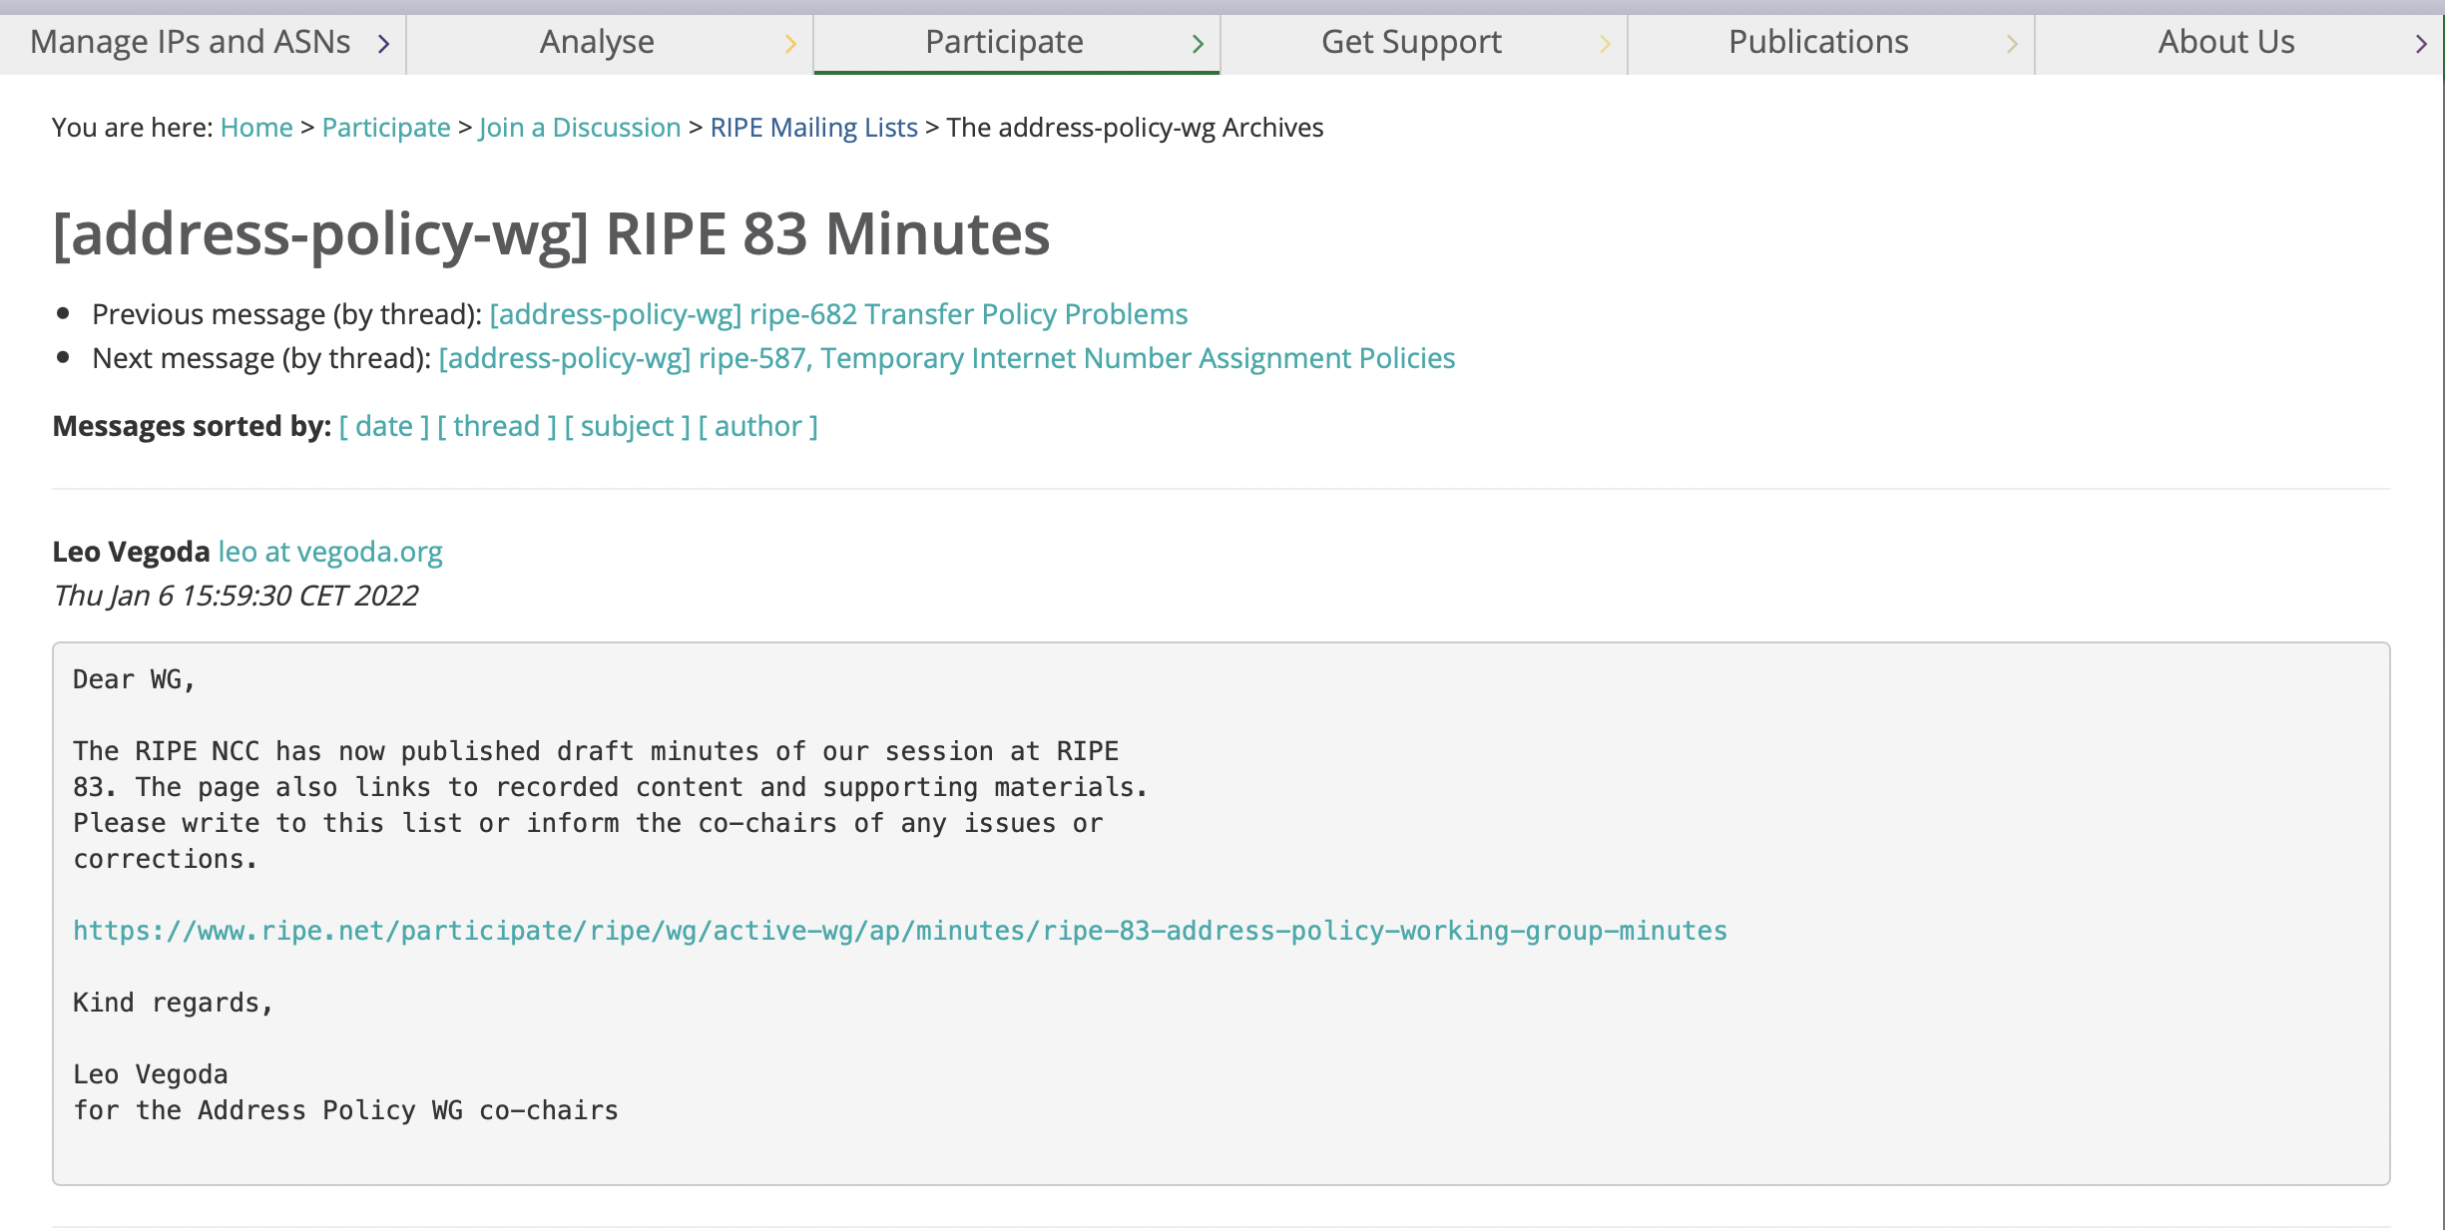
Minutes from RIPE 83
Posted on 6 January 2022
No comments Are changes needed or can we accept them?

Slide 6
Agenda
Introduction, including appointment of co-chair (10 mins)
NRO NC Update (10 mins)
Policy Update followed by Q&A (15 mins)
IPv6 Policy Goals report from community team followed by discussion (25 mins)

Slide 7
Agenda
☕

Slide 8
Agenda
Registry Services Update followed by Q&A (15 mins)
Concept Policy Proposal - Remove mandatory IPv4 PA self assignment registration in the RIPE Database (20 mins)
IPv4 Waiting List (20 mins)
AOB/Open Mic (5 mins)

Slide 9
Thank you!
Make sure you provide input on policies via the mailing list address-policy-wg@ripe.net
See you at RIPE 85 in the autumn!

