Slide 1
The sad reality of QUIC handshakes: How bad configuration leads to delay or DDoS.
Marcin Nawrocki, Nicholas Banks, Raphael Hiesgen, Thomas C. Schmidt, Pouyan Fotouhi Tehrani, Matthias Wählisch
{marcin.nawrocki, m.waehlisch}@fu-berlin.de nibanks@microsoft.com pouyan.fotouhi.tehrani@fokus.fraunhofer.de {raphael.hiesgen, t.schmidt}@haw-hamburg.de
Notes:
[intro + other authors]
since this is the last plenary session, lets have a quic recap on what happened during the first plenary session.

Slide 2
Recap: RIPE 84 on Monday
Notes:
as you can see, thomas king said, that latency is the new currency of the internet
and i agree. we really try to deliver content to users as fast as possible.
most CDNs to this by bringing content closer to its users, but this is not always possible. so the latency stays high.

Slide 3
Design goals of QUIC handshakes.
Reduce round trip times. TCP/TLS/HTTP handshakes coalesced into 1RTT.
Prevent UDP amplification attacks. RFC limits response size to 3x of an (unauthenticated) request.
Notes:
so what else can we do? design better protocols!
if the latency is high, every RTT hurts. it really hurts a lot.
this is why the QUIC protocol has been designed to reduce round trips.
basically before we had 3 round trips because of independent TCP – TLS – HTTP handshakes.
QUIC merges all this into a single handshake process.
Since QUIC ist based on UDP, we also had to prevent amplification attacks.
we wanted to prevent the same mistakes from the past, dns amplification attacks, ntp amplification attacks, they are still very common
So there is actually a limit for servers, server are only allowed respond with triple the bytes they have received from a client.

Slide 4
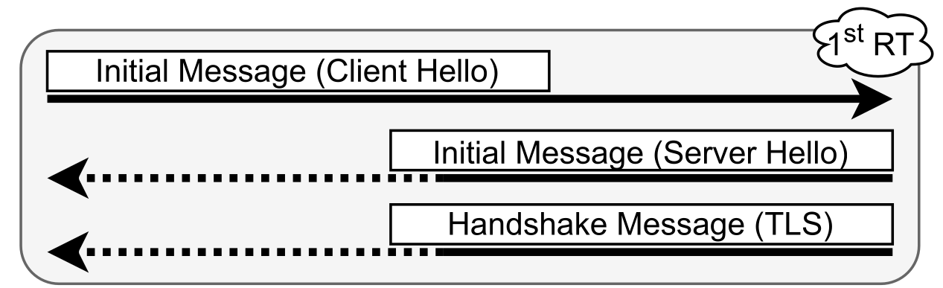
In practice.
Client
Server
Should be ≤3x INITIAL.
Mainly steered by TLS cert.
Under the control of the server.
Notes:
let’s take a look how the QUIC handshake looks in practice.
first, the client sends a quic INITIAL message, sth like a tcp syn packet.
However, this packet is not small, the client uses padding to send large INITIAL packets because of the response size limit.
client INITIALs are at least 1200 bytes.
the server then responds with a initial message and a handshake message containing TLS data.

Slide 5
We actively scanned 1k top domains.
Notes:
so we wanted to know whether quic handshakes really work as expected
this is why we actively scanned 1000 top domains. currently, only 169 top domains have a QUIC server running.
so in total, we looked at 169 domains.

Slide 6
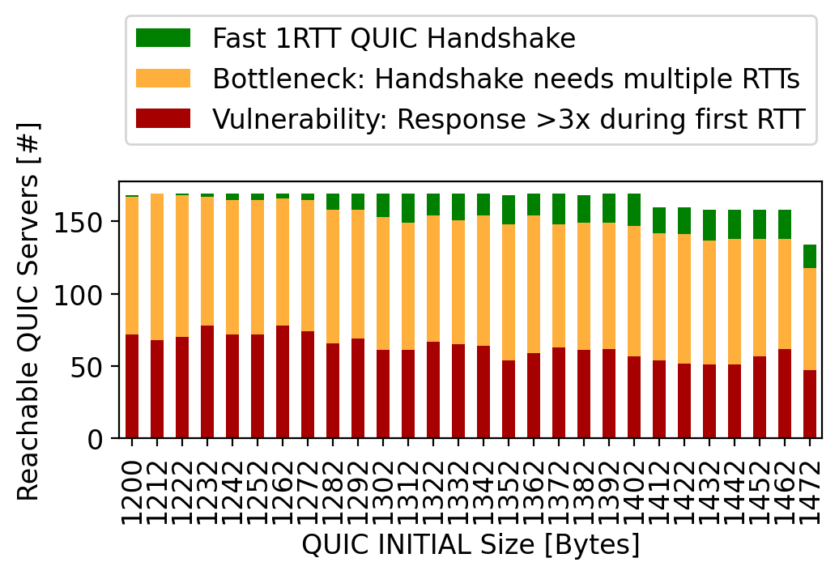
Have the design goals been met? No!
Notes:
and our overall result is that the design goals have not been met in practice.
let me walk you through our plot: this is a stacked bar chart for the 169 servers.
our client was sending initial messages containing 1272 bytes.
however, around half the servers responded with more bytes the current amplification limit, that’s the red bar.
roughly the other half of handshakes unfortunatelly used ultiple RTTs
only a small percentage of handshake really had the fast 1RTT handshake that we want qith quic.

Slide 7
Have the design goals been met? No!
Configuration issue?
Implementation issue!
Notes:
the red bar ist pretty bad – we think these are implementation issuues because they dont respect the rfc
the orange is more complex, and might be because of ineffecient configuations.
and this talk is actually structured around this plot, so we wil check what hapannes if we send smaller INITIALS so we go to the left, or large INTIALS, so we go to the right.
and then, we will discuss the differenct cases, so we will talk about the red orange and green bars in detail

Slide 8
Small QUIC INITIALs lead to multiple RTTs.
Notes:
what happens if we go to the left?
well, almost all handshakes require multiple round trips because the servers are not allowed to respond with so many bytes.

Slide 9
~1350 bytes are the sweet spot.
Notes:
if we go to the right, we first observe more of fast 1RTT handshakes, which is good.

Slide 10
Larger QUIC INITIALs reduce reachability.
Notes:
however, too large initials cause packet drops, so we were unable to reach several domains with very large intials near the max MTU..

Slide 11
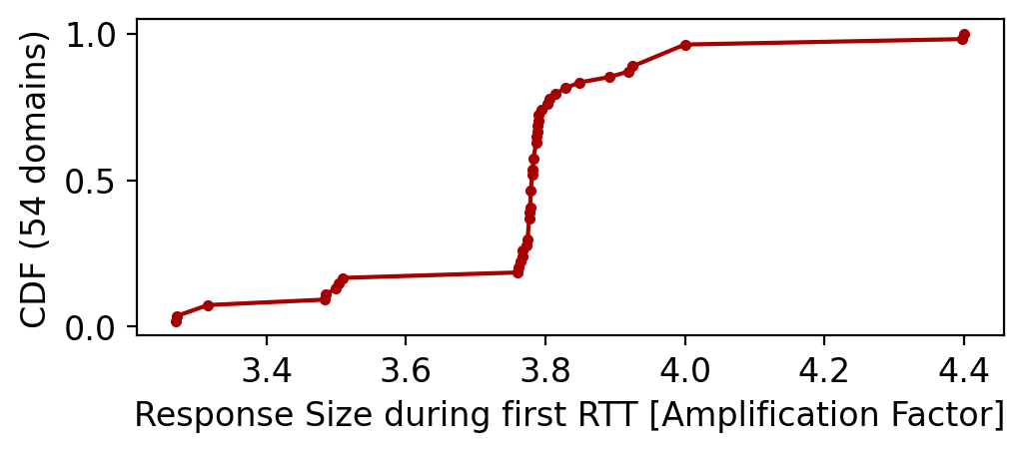
How bad is the amplification? Not bad.
Notes:
allright, lets talk now about the red bars: → how bad is the amplification?
this cdf is based on a 1352 INITIAL, so quite large.
what we see is that in most cases the amplification is not that bad, usually, when we see that the limit is not respected, it is less than 4x

Slide 12
How bad is the amplification? Not bad.
Some implementations need bug fixes, though!
Notes:
but still, some implementations to not respect the RFC, so they need some bug fixes.
(can we figure out which implementations are affected?)

Slide 13
What causes multiple RTTs?
RETRY tokens (DDoS prevention)
Large TLS certificates
(in conflict with the 3x limit)
Only 2 domains.
The majority!
Notes:
lets checkout the orange bars, so what causes multiple RTTs?
there are two possible reasons.
first one are retry tokens – a form of ddos prevention and very much like tcp cookies.
before so the server responds with an initial which allocates all the memory, performs TLS computations and so on, it simply sends a retry token and waits for the client to come back.
however, retry tokens are very rare. only 2 websites use RETRY in our tests, which belong to a russian speaking social media platform.
the second reason are too large TLS certificates, which are in conflict with the response size threshold. that’s the majority

Slide 14
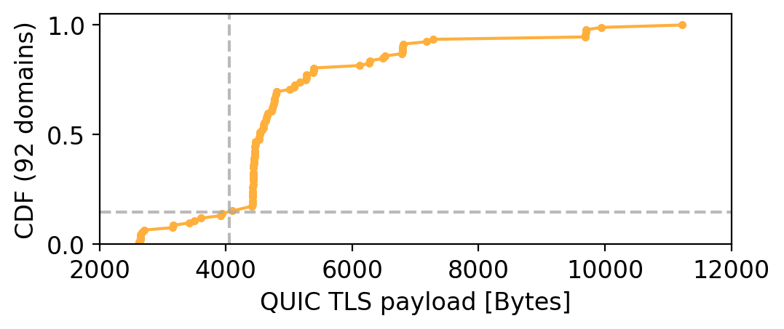
85% of TLS data exceed the 3x threshold!
This causes multiple round trip times.
Notes:
again, we have a cdf for this cases.
so this cdf shows the distribution of tls data for the orange domains, so for the cases where we had multiple round trips.
in almost all cases, we received more than 4000 bytes.
and actually, everything in the upper right area is so large that it has to be send with multiple round trips.

Slide 15
What is the best-performing INITIAL size to not induce an additional RTT given current TLS certs?
Currently, it is ~1350 bytes. Trade-off: Small INITIALs trigger multiple RTTs due to large TLS certificates. Large INITIALs reduce reachability because QUIC forbids IP fragmentation!
Notes:
lets talk quickly about the green bar, when things work well.
currently, the best INITIAL size is around 1350 bytes.
this is because of the trade off that we observed in my plots

Slide 16
Recommendations to operators if you care about delay and DDoS prevention
Reduce the size of your TLS data! Be below 3x of common requests to fit into the 1RTT handshake.
Activate RETRY tokens! QUIC INITIAL DDoS floods are a rising threat vector! [ACM IMC’21] RETRY enables DDoS prevention for ZERO additional cost compared to current deployments (with multiple RTTs).
Notes:
so, what do we learn from our measurements, is there anything we can recommend
first, try to fit into the triple response size limit, so that you get the nice 1RTT handshake that QUIC offers
obviously, i know, this is difficult because the tls ecosystem is quite complex
on the other hand, if you are forced to use handshake with multiple round trips anyway, you can activate retry.
this is basically free ddos prevention for you without any penalty, because you already have multiple roun trips

Slide 17
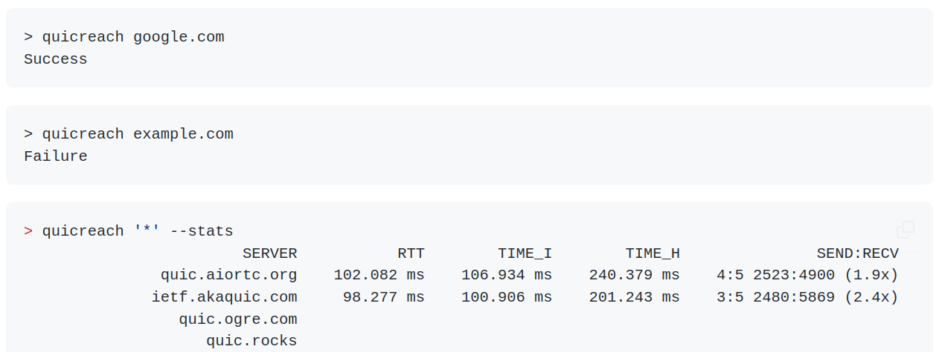
Test your QUIC server today! An open source tool.
https://github.com/microsoft/quicreach
Notes:
btw, you can repeat all our measurements by yourself.
quicreach, the tool we used, is open source.
quicreach is based on microsofts implementation of QUIC, which very much will be used in the future by microsoft producs

Slide 18
Check your QUIC / TLS deployment!
Notes:
so, use our tools and check your QUIC / TLS deployment!

Slide 19
Backup

Slide 20
Are you saying we should increase the 3x limit?
No. Let’s first find out what a space-efficient but secure TLS config looks like. The 3x limit could encourage optimal configs.
Notes:
in todays internet and web ecosystem

Slide 21
How can you decrease your TLS data size?
Use algorithms with smaller signature footprint (elliptic instead of RSA).
We observe certificates with a long list of Subject Alt Names (SANs), reduce them!
This is a joint effort due to certificate chains.

Slide 22
Load balancers also add bloat!
We are scanning top domains with a very large user base. → Load balancers.
Packet encapsulation is used between L4 and L7 load balancers (+20 bytes).

Slide 23
RFC 9000 and the 3x threshold for unvalidated clients
8.1. Address Validation during Connection Establishment
Prior to validating the client address, servers MUST NOT send more than three times as many bytes as the number of bytes they have received.
17.2.5. Retry Packet
An opaque token that the server can use to validate the client's address.

Slide 24
RFC 9000 and IP fragmentation
14. Datagram Size
UDP datagrams MUST NOT be fragmented at the IP layer. In IPv4 [IPv4], the Don't Fragment (DF) bit MUST be set if possible, to prevent fragmentation on the path.

Slide 25
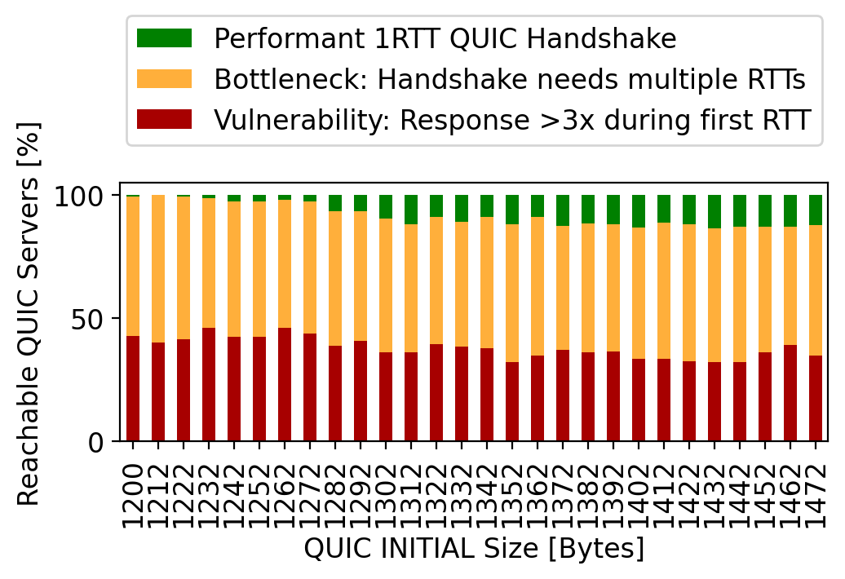
QUIC INITIALS (relative).

Slide 26
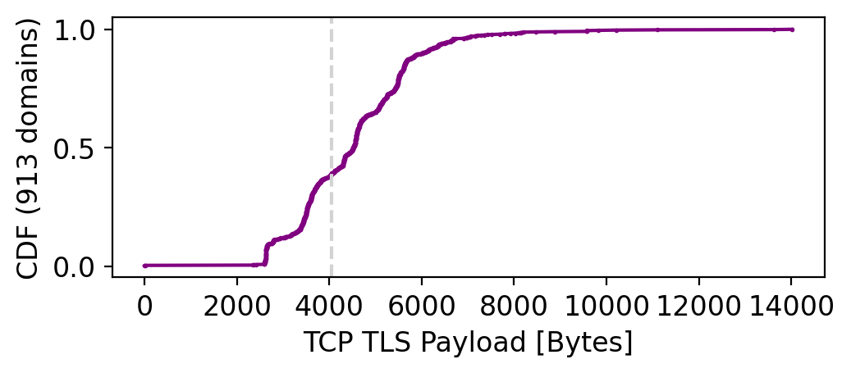
>50% of 1k top domains have large TLS certificate data!

Slide 27
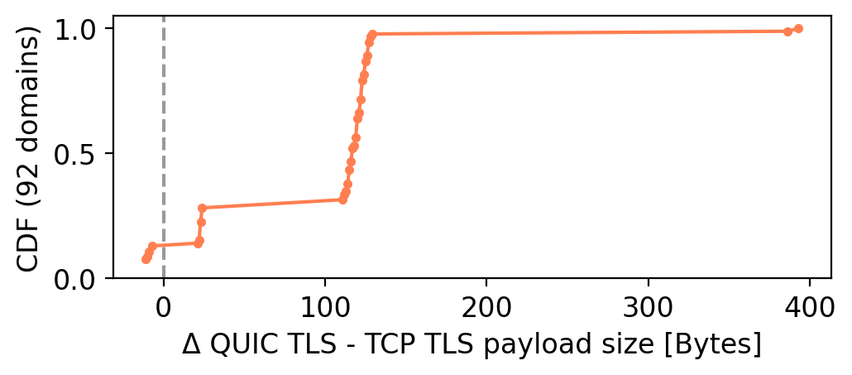
QUIC vs TCP certificate data.
TLS data received over QUIC or TCP has roughly the same size. We observe ~100 bytes more with QUIC.

