Slide 1
Reducing “Unwanted/Bad” traffic

Slide 2
Biggest benefits
No more captcha
Less overall power consumption
Room for improvement
But in my opinion best of all
Less opportunities for hackers

Slide 3
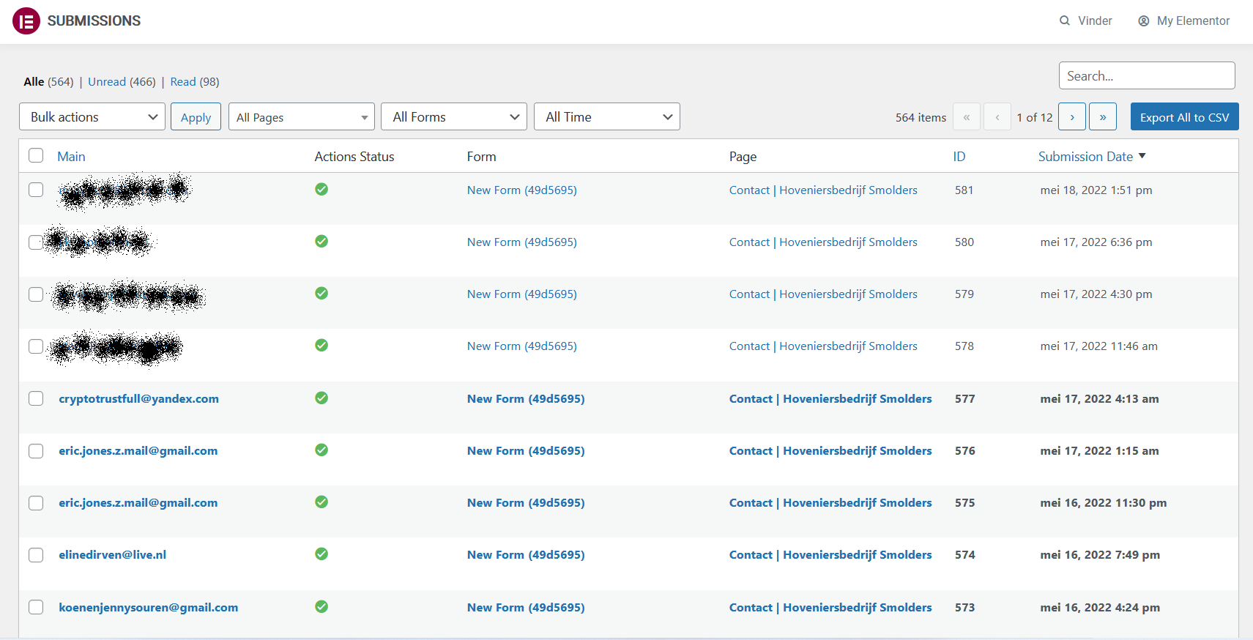

Slide 4
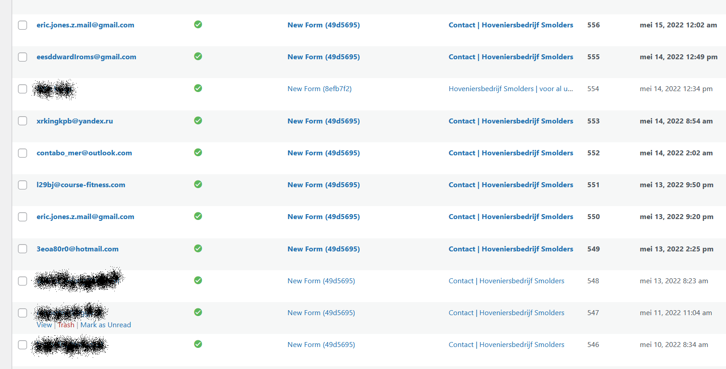

Slide 5
